Slide 1

<Online Daycare Centre>

Slide 2


Slide 3

Group Member Introduction:-
Group Id: < S2302F7B24>
Supervisor Name :<Jibran khan>
VU ID : <BC220413324 , BC220406062>
Student Name: <Asia Abbas, Abiaz Zahra>

Slide 4


INTRODUCTION OF PROJECT:-
This project started to address the challenges faced by working parents in managing their daily responsibilities along with parenting duties. The goal is to develop an online daycare application to provide convenient and efficient solutions for working parents.
The key objectives of this project are to create an online daycare platform that allows working parents to search for and book daycare services based on their requirements. The aim is to assist parents in managing their parenting responsibilities effectively while balancing their work commitments.

Slide 5
Functional Requirements:
FR1:- Users will be able to create an account by signing up a form.
FR2:- The form will consist of basic information such as name, address, phone# and email address for future reference.
FR3:- Users will be divided into two categories i.e. Daycare or parents.
FR4:- Parents will be able to create detailed profiles.
FR5:- Form will consists of all required information such as name, address, contact number, emergency contact number and emergency contact details, full time of part time child support, area, and time duration for Daycare.
FR6:- Daycare will be able to create a detailed profile consisting of child care details such as basic information, professional qualification, Daycare experience, qualification or diplomas/Training.
FR7:- Daycare Centre will be responsible for adding pictures of the facilities they are providing in their profile.
FR8:- Moreover Daycare will be able to mention if they provide services at home or at the facility.

Slide 6
Functional Requirements:
FR9:- The facilities in Daycare Centre needs to be mentioned in the profile such as CCTV, nursing facilities, Number of nursing staff, number of medical staff.
FR10:- Daycare will be able to post a review of the child based on their experience and observation.
FR11:- Daycare will be able mention their fee and payment options.
FR12:- Daycare will be able to generate income report for a specific month or for a selected period of time.
FR13:- Daycare will be able to generate expense report for a specific month or for a selected period of time.
FR14:- Daycare will be able to search for a specific child and his/her history.
FR15:- Daycare will be able to find number of appoints for a specific day or future dates.
FR16:- Daycare will be able to keep complete attendance of children dropped at the facility.

Slide 7

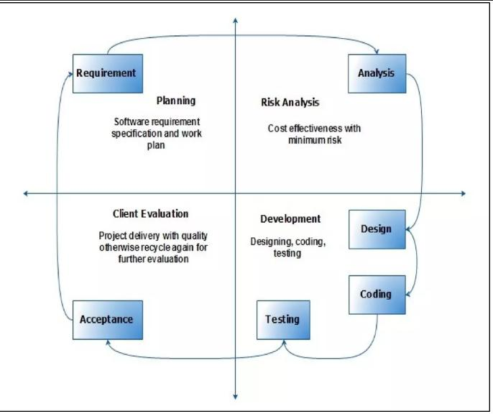
VU Process Model:-

Slide 8
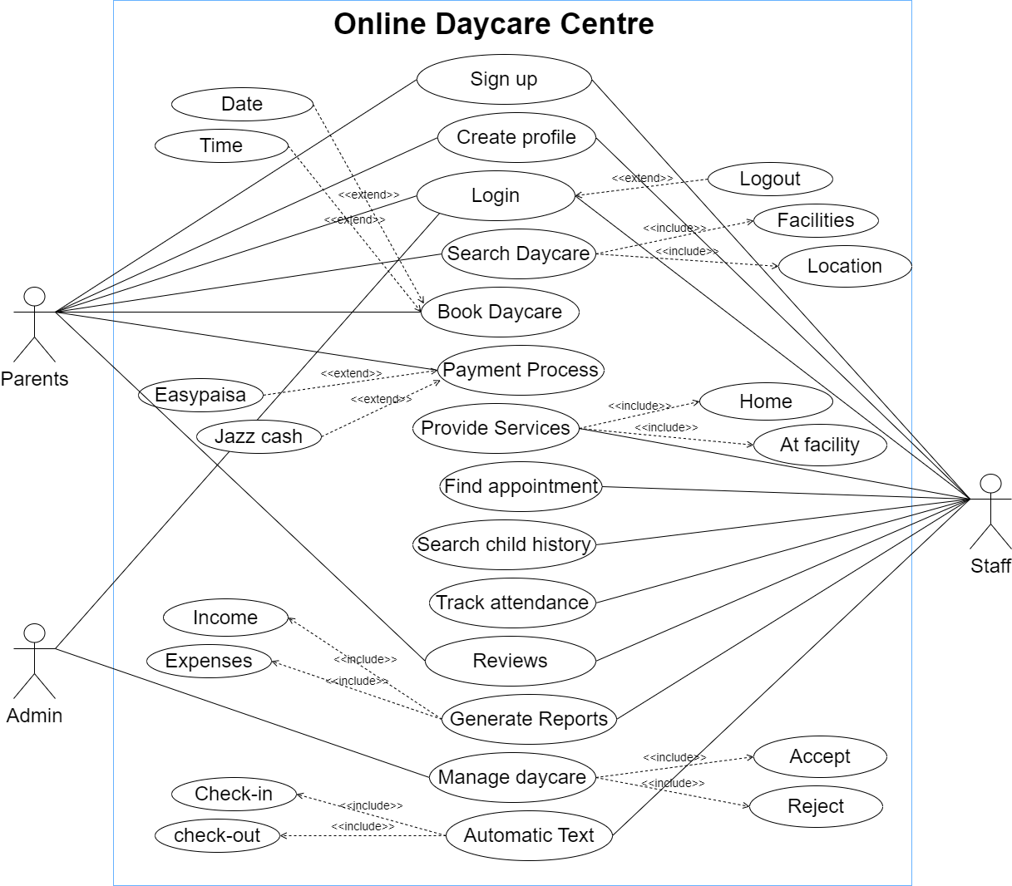
Use Case Diagram:-

Slide 9

Functional Requirements:
FR17:- Daycare will be able to check the attendance record of children monthly or for a specific period of time.
FR18:- Daycare will be able to send an automatic text message when the child is received or dropped from the Centre.
FR19:- Parents will be able to pay from their phone.
FR20:- Parents will be able to write a review of the daycare for other parents to read.
FR21:- Application will be able to suggest suitable options for parents as well.
FR22:- Administrator will be able accept or reject Daycare based on their profiles.

Slide 10

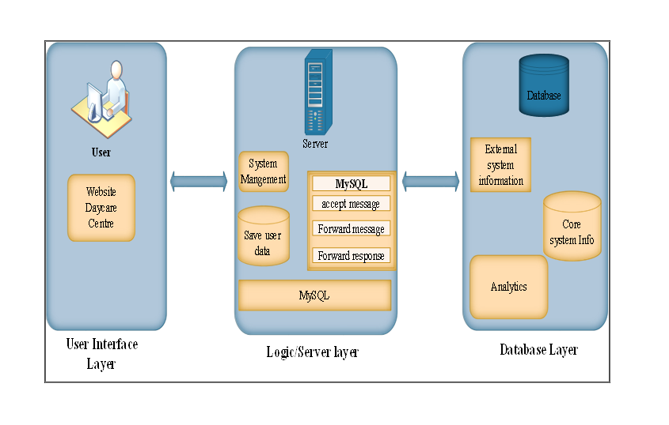
Architectural Design:

Slide 11

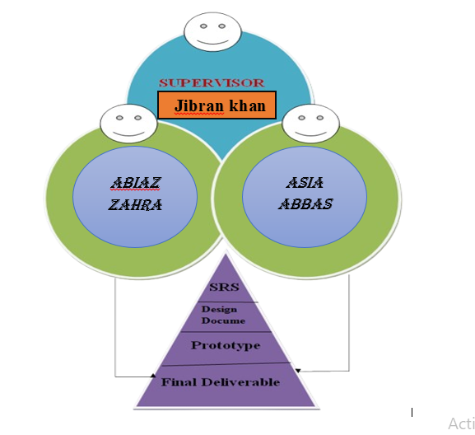
Team work

Slide 12

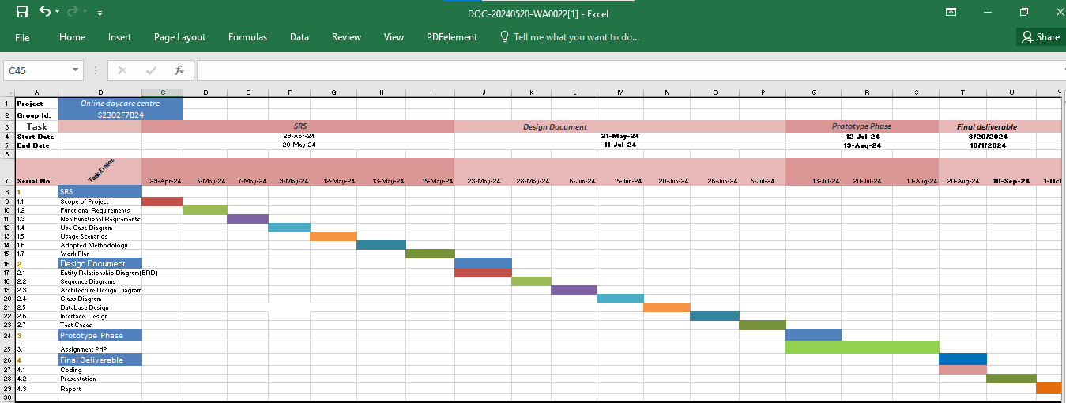
Project Schedule:

Slide 13
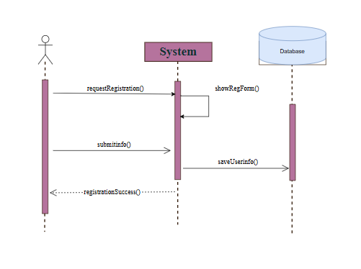
SEQUENCE DIAGRAM REGISTER ACCOUNT

Slide 14
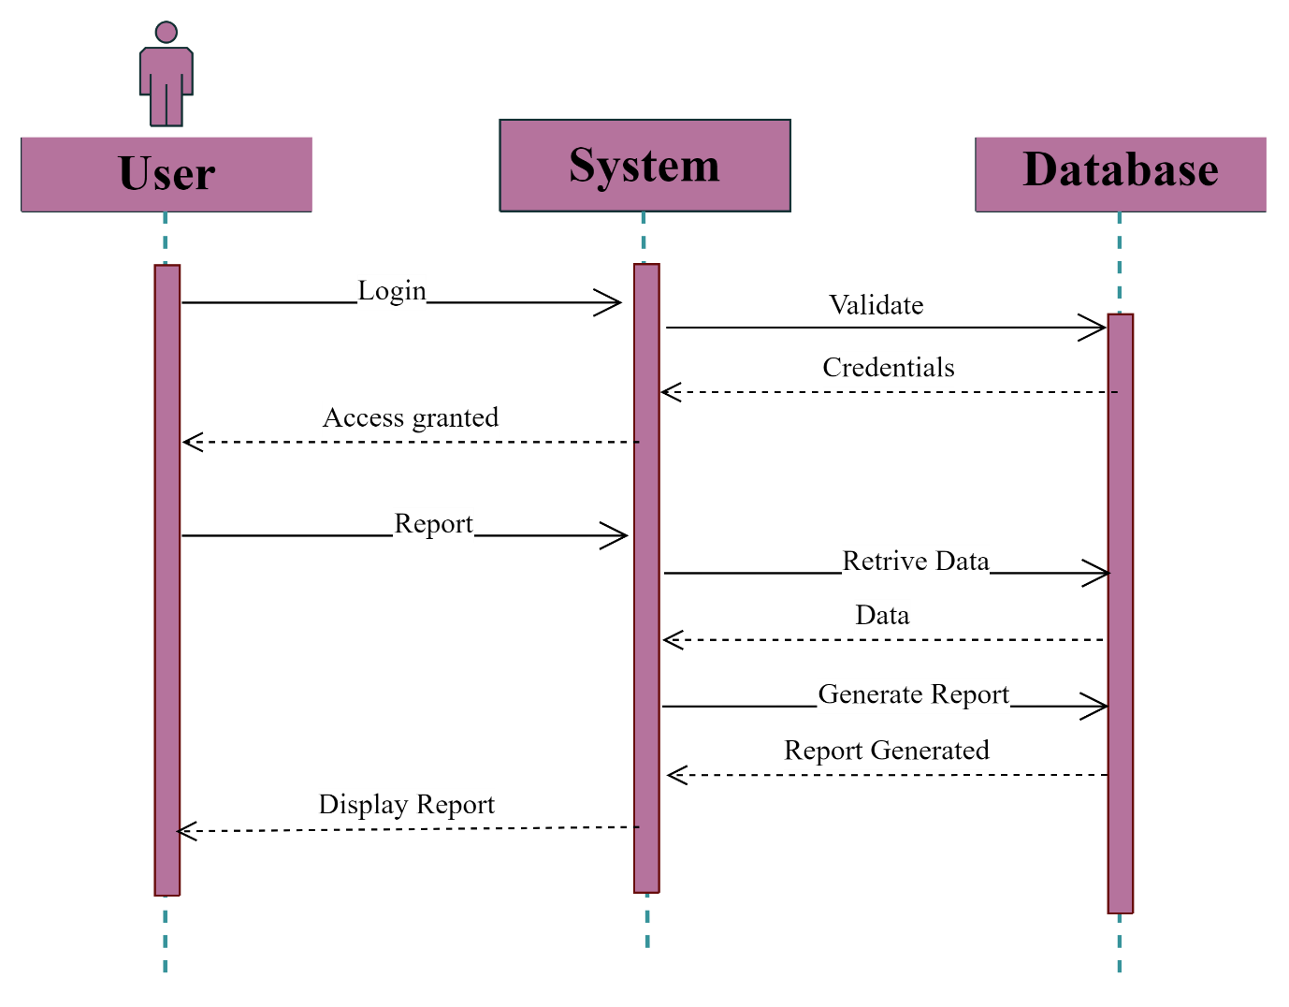
LOGIN

Slide 15
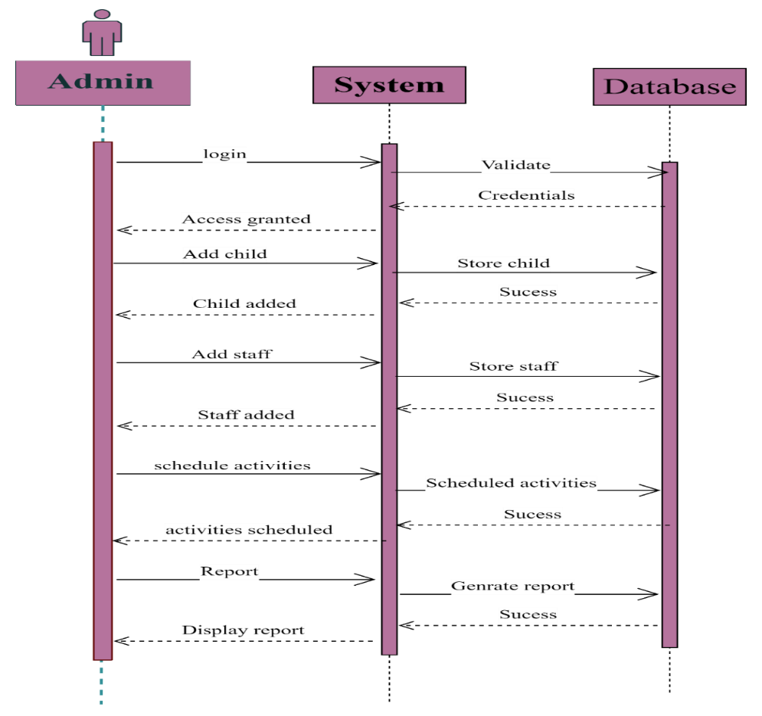
ADMIN

Slide 16
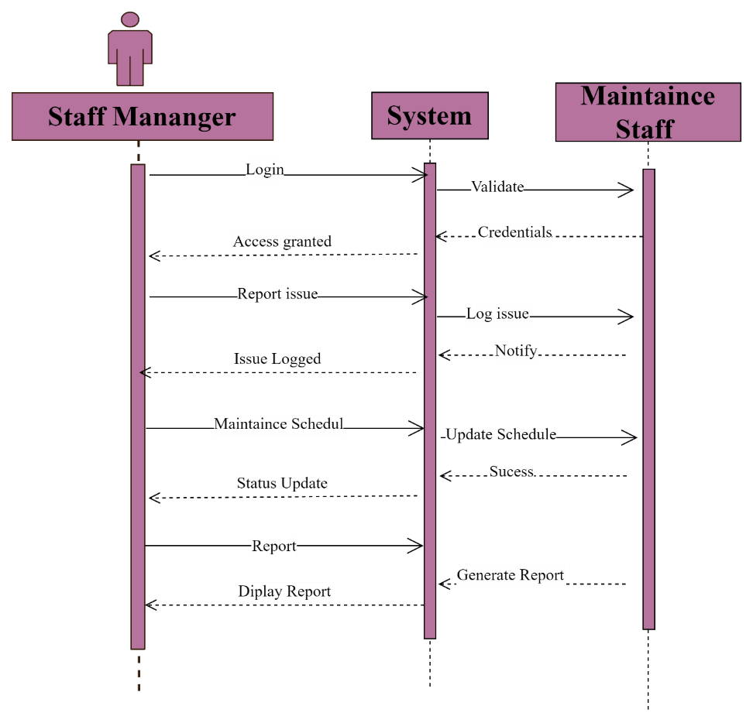
STAFF MANAGER

Slide 17

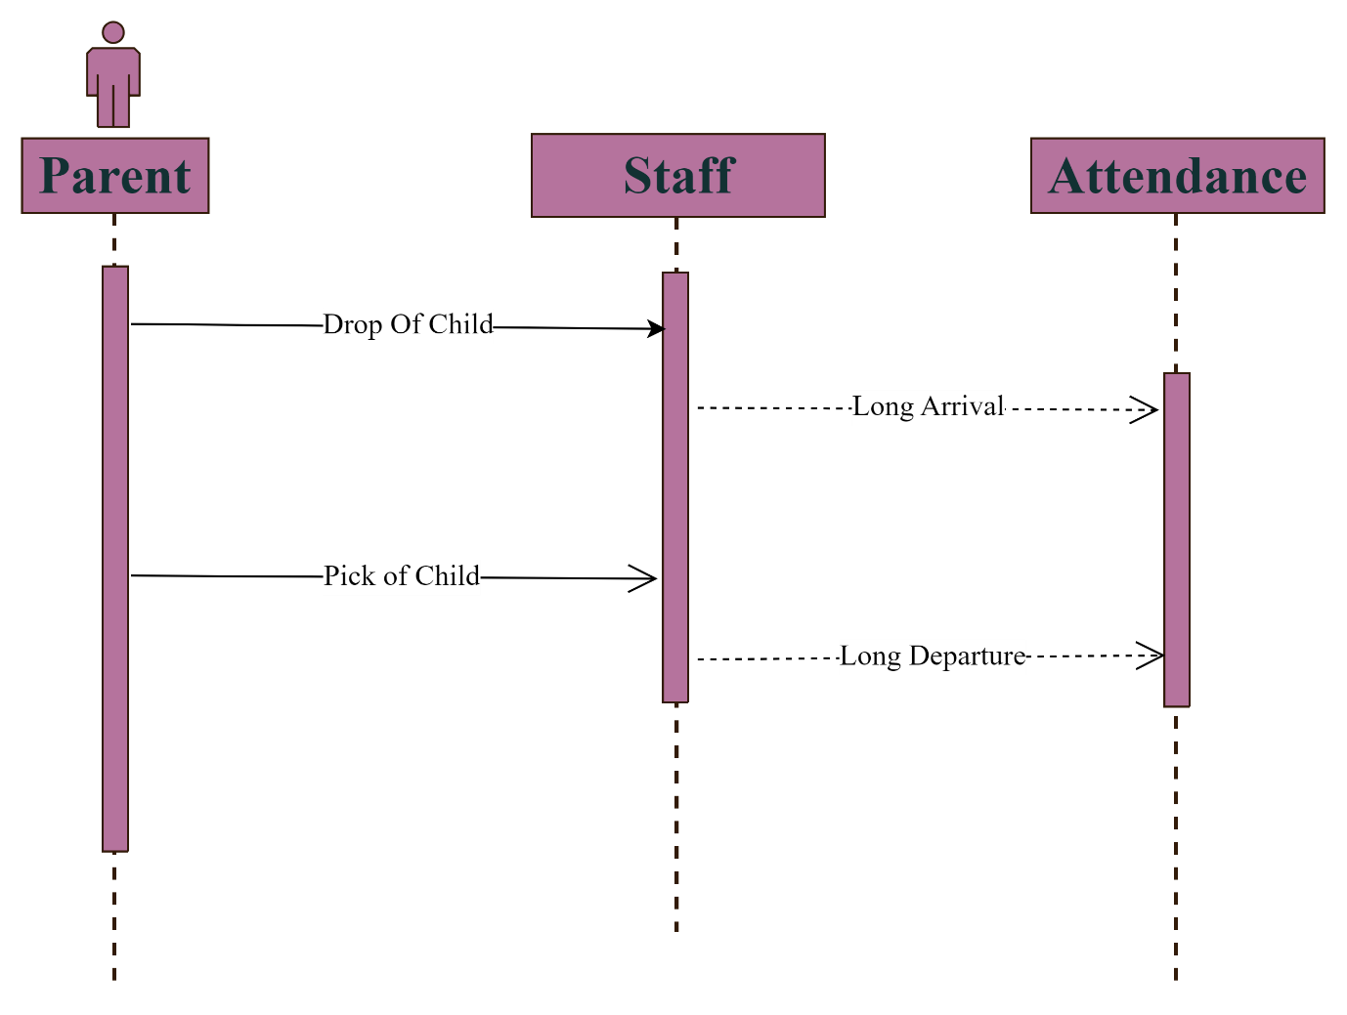
ATTANDANCE

Slide 18
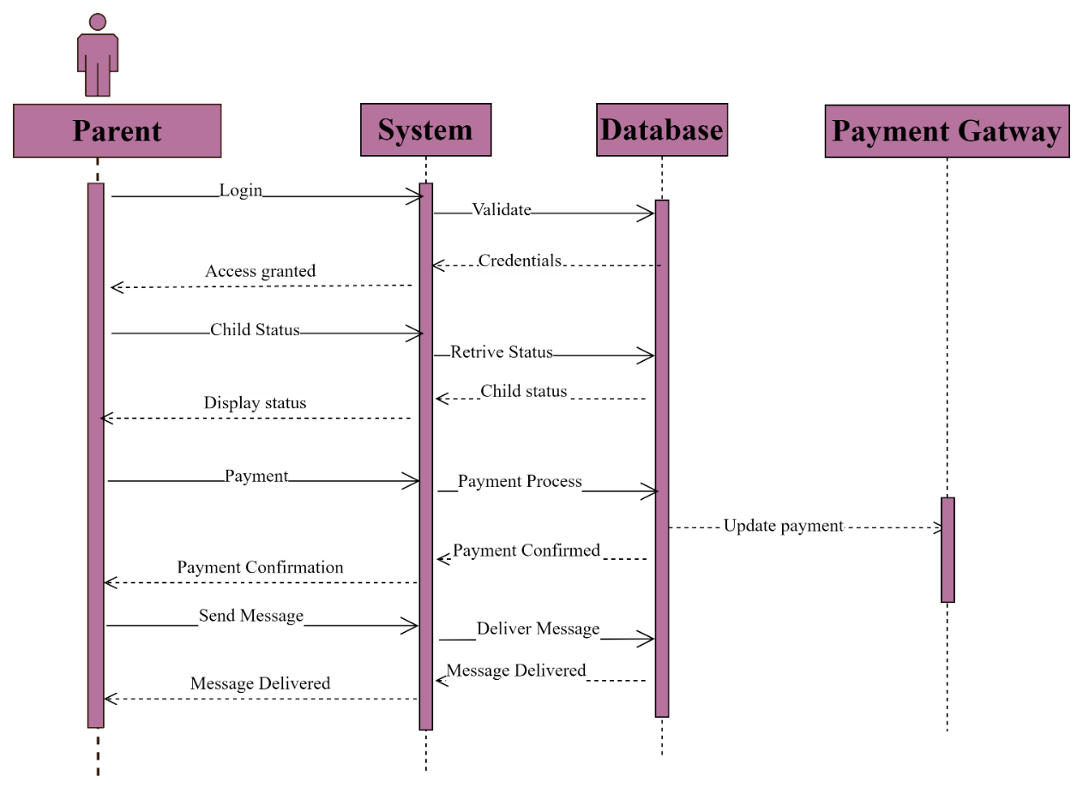
DAYCARE REPORT

Slide 19
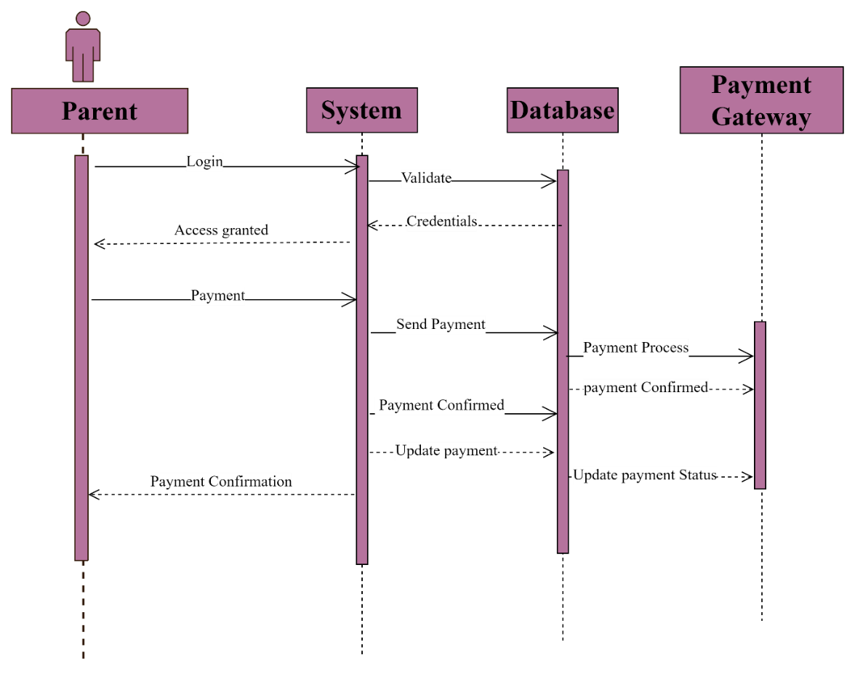
PAYMENT

Slide 20
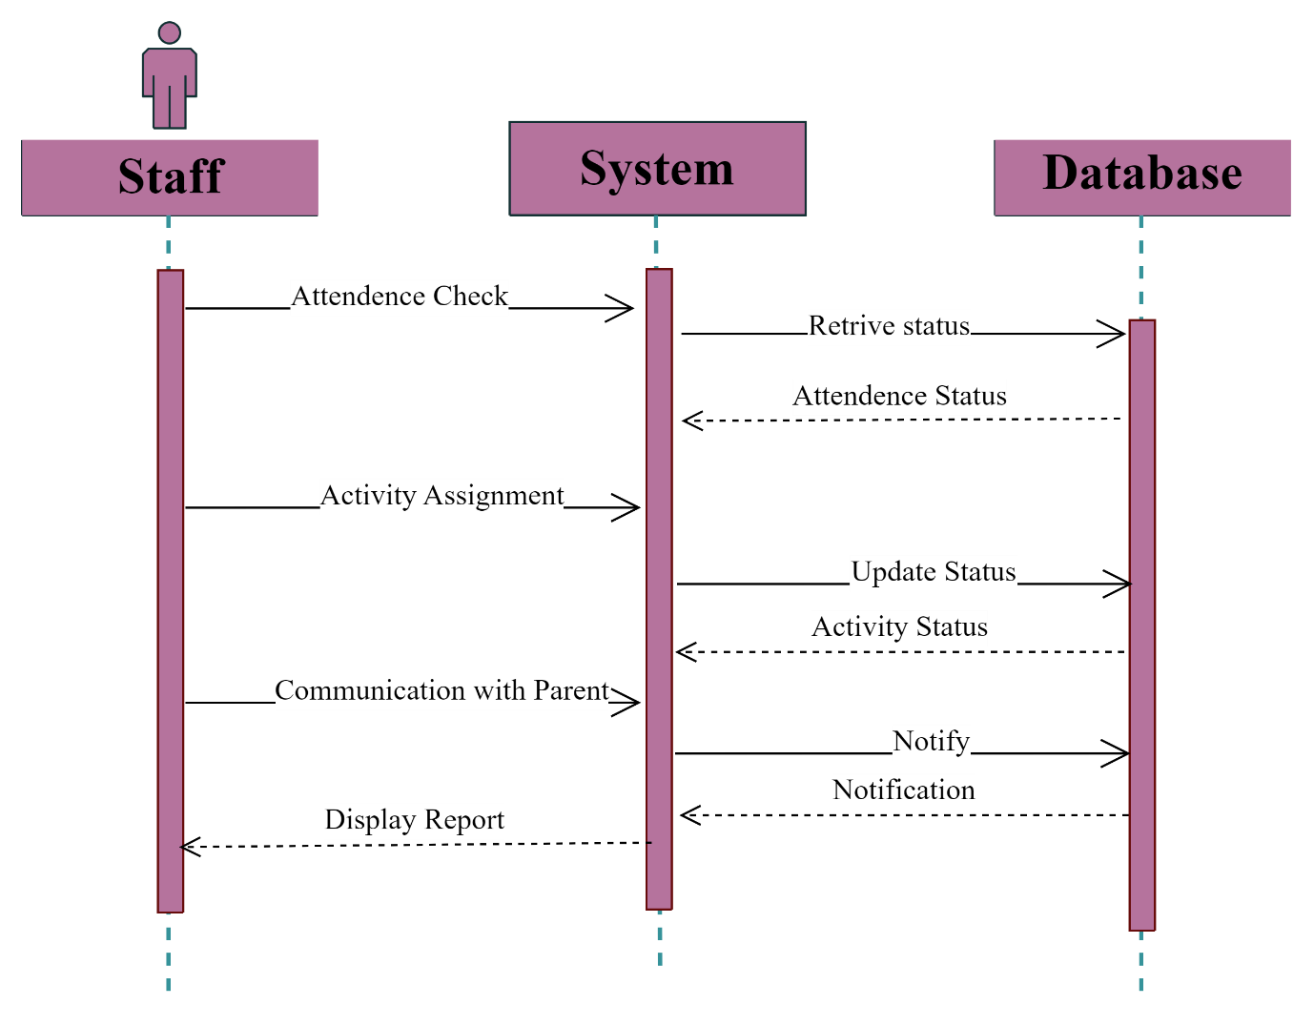
CHILD

Slide 21
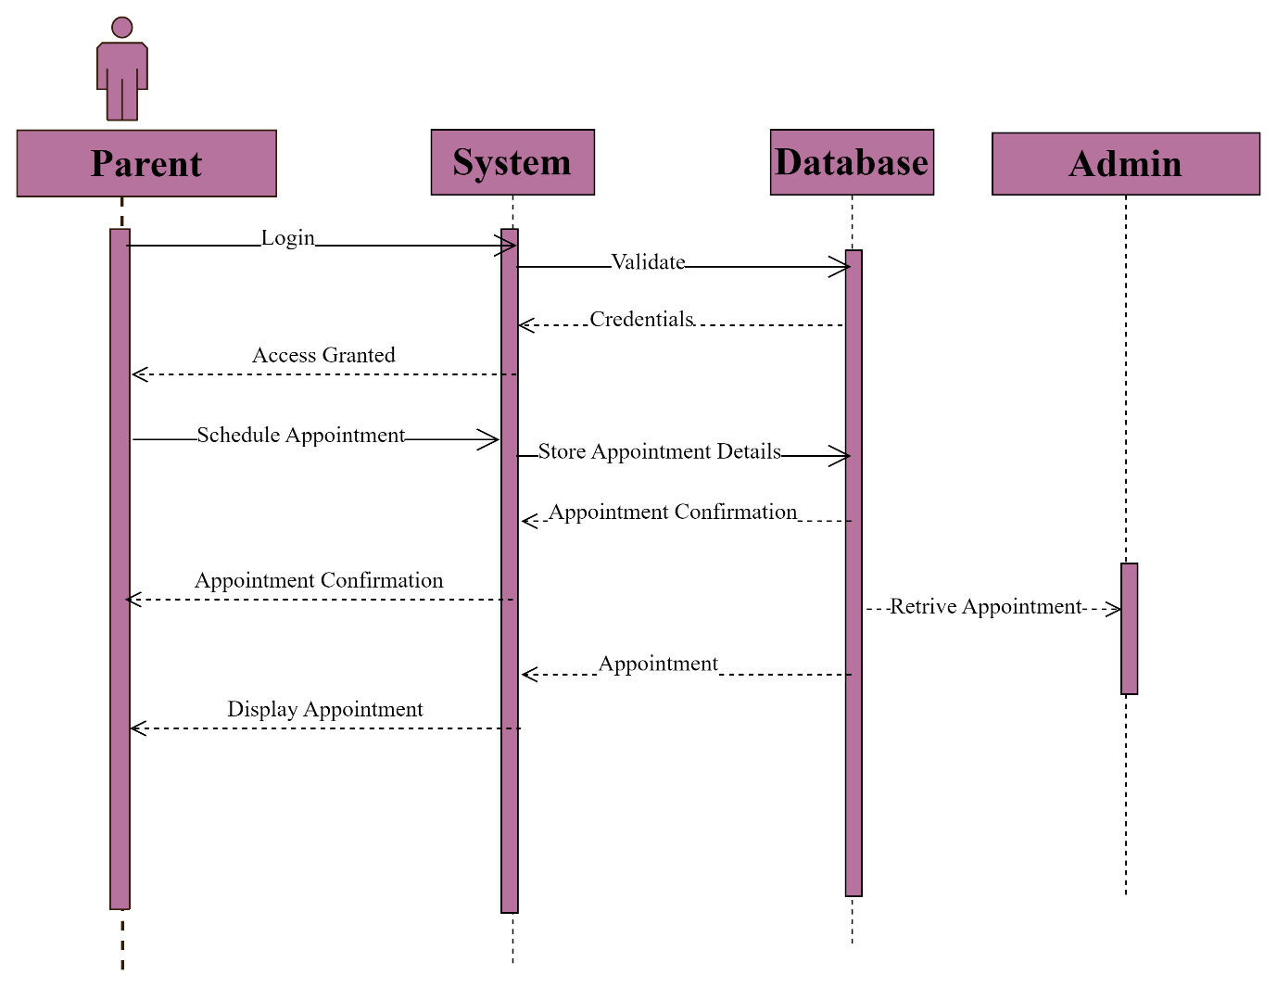
APPOINTMENT

Slide 22
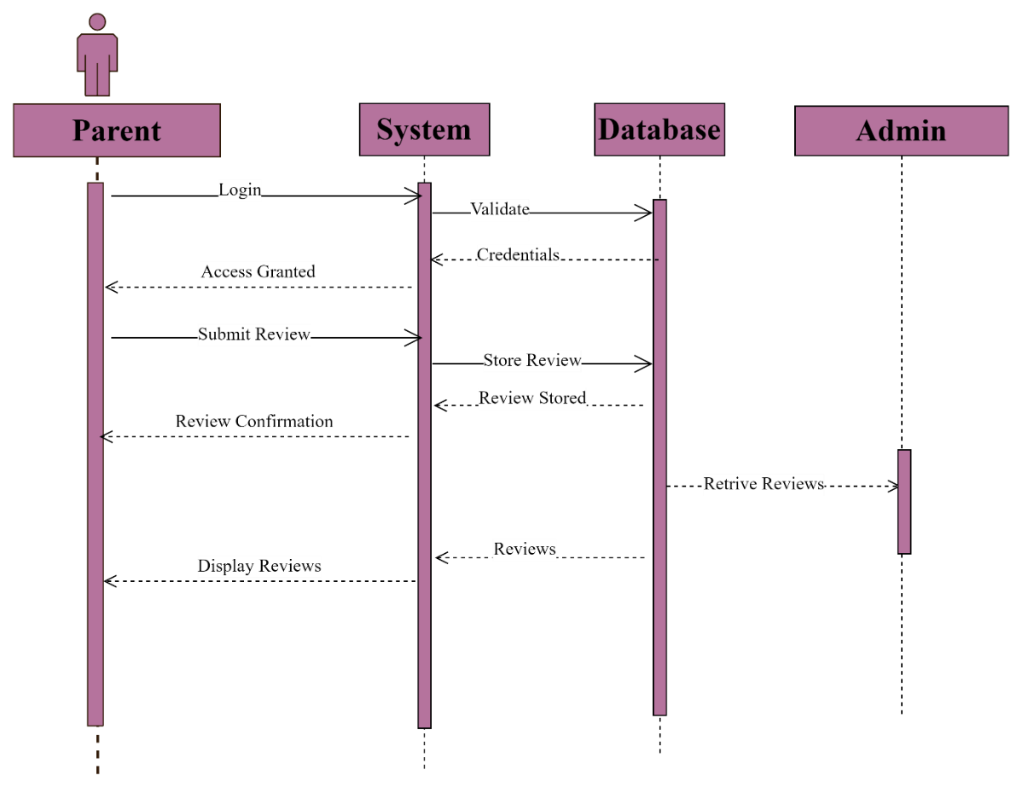
Reviews

Slide 23
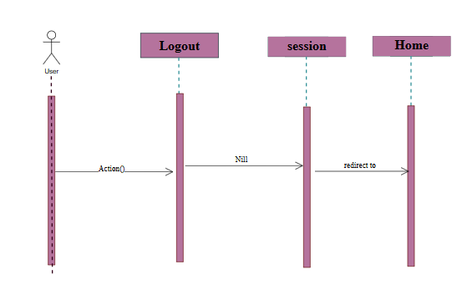
SEQUENCE DIAGRAM LOGOUT

Slide 24
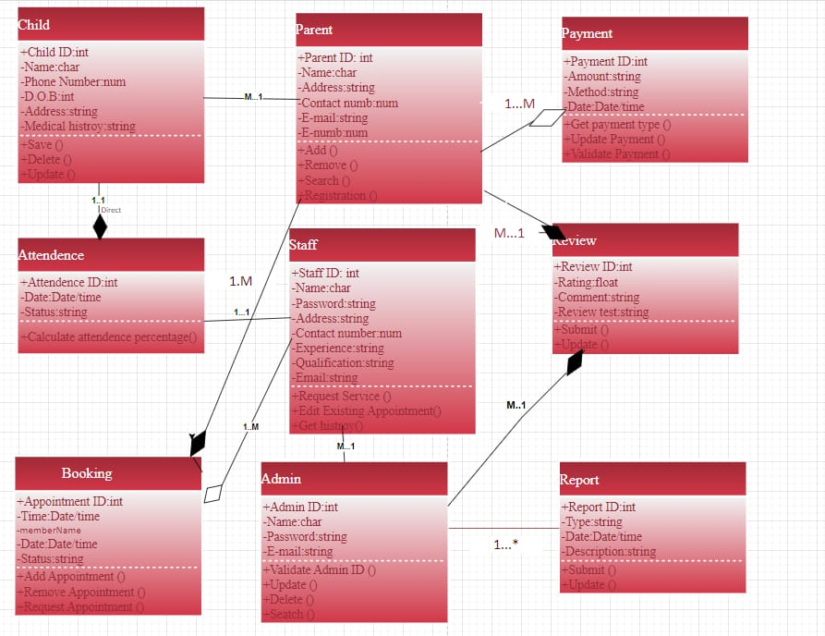
Logical Model|Class Diagram:

Slide 25
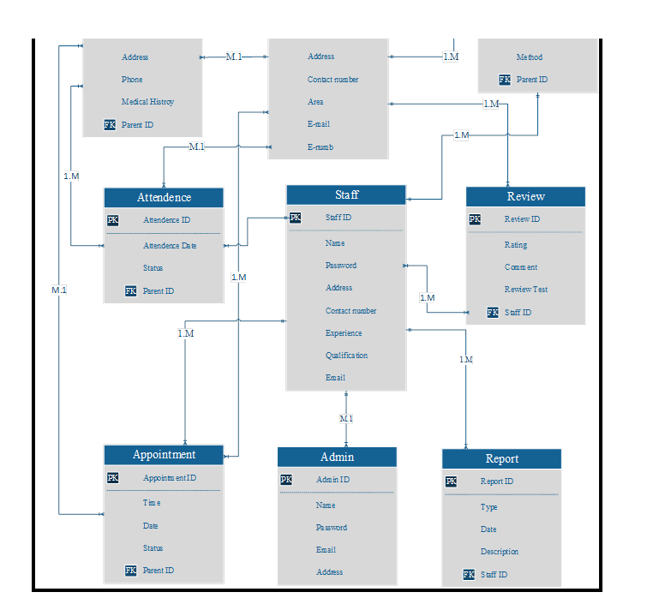
Database Diagram:

Slide 26
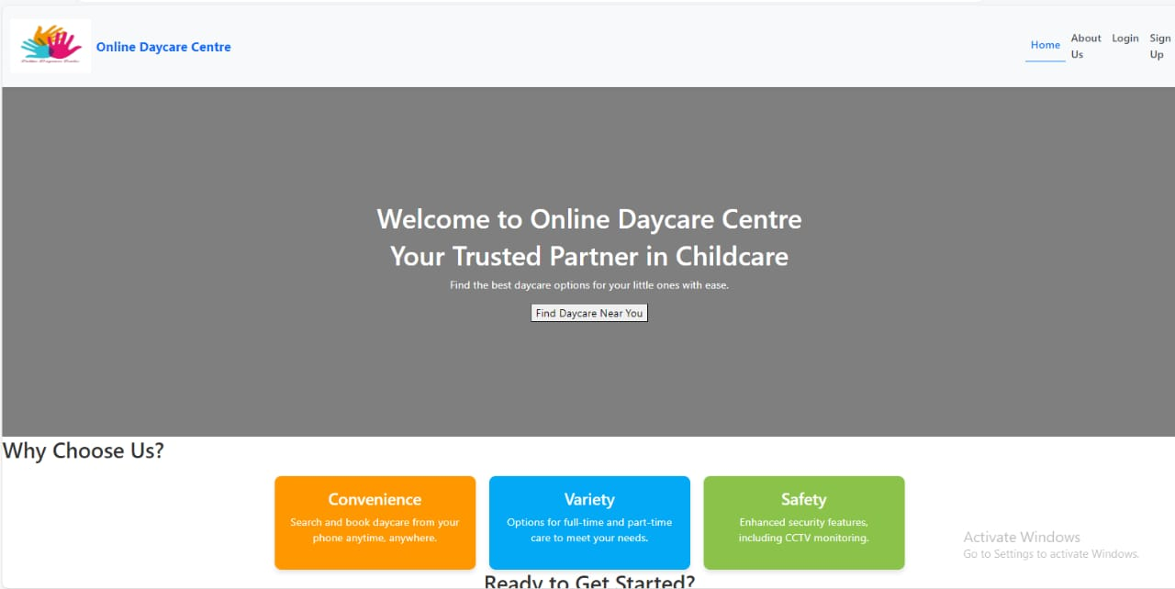
GUI (Home Page)

Slide 27
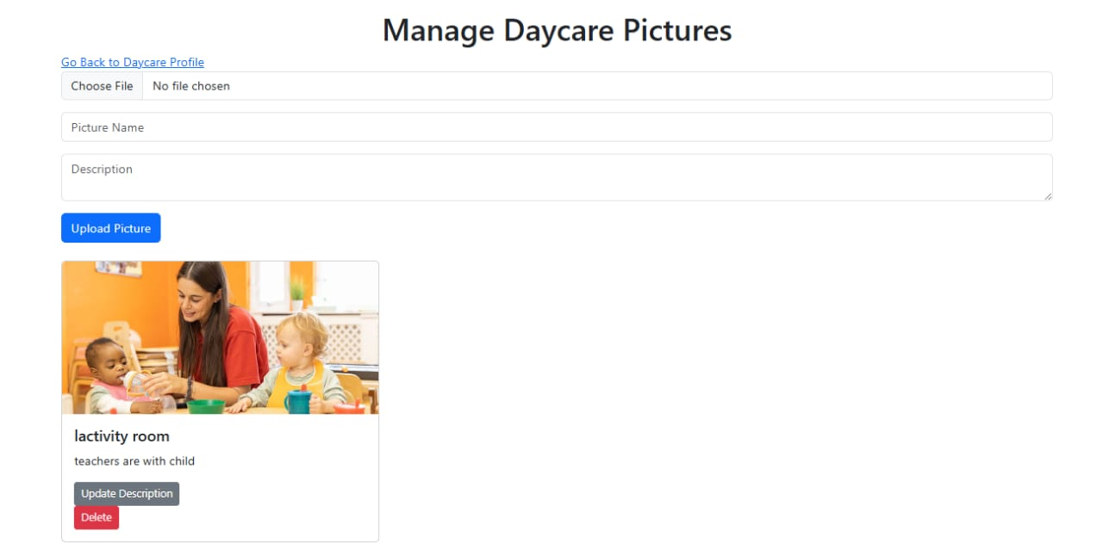
GUI (manage daycare picture)

Slide 28
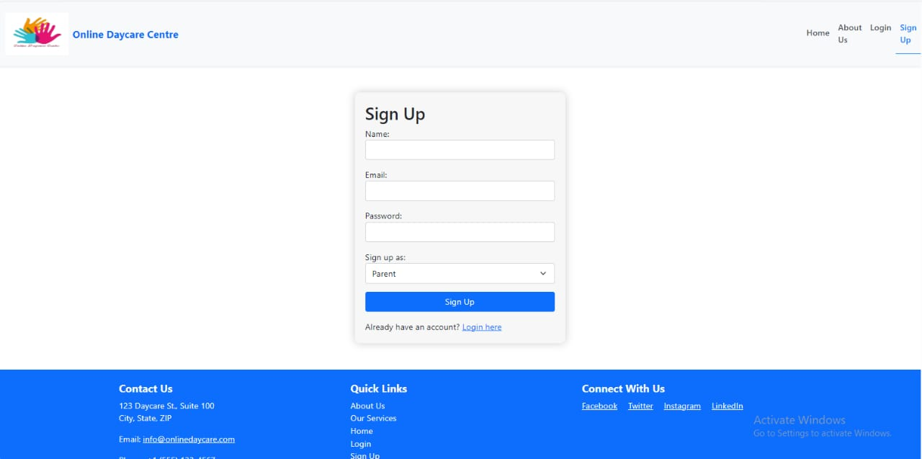
GUI (Register Account)

Slide 29
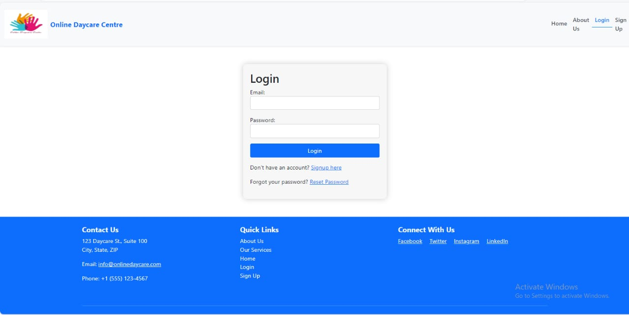
GHI (User login)

Slide 30
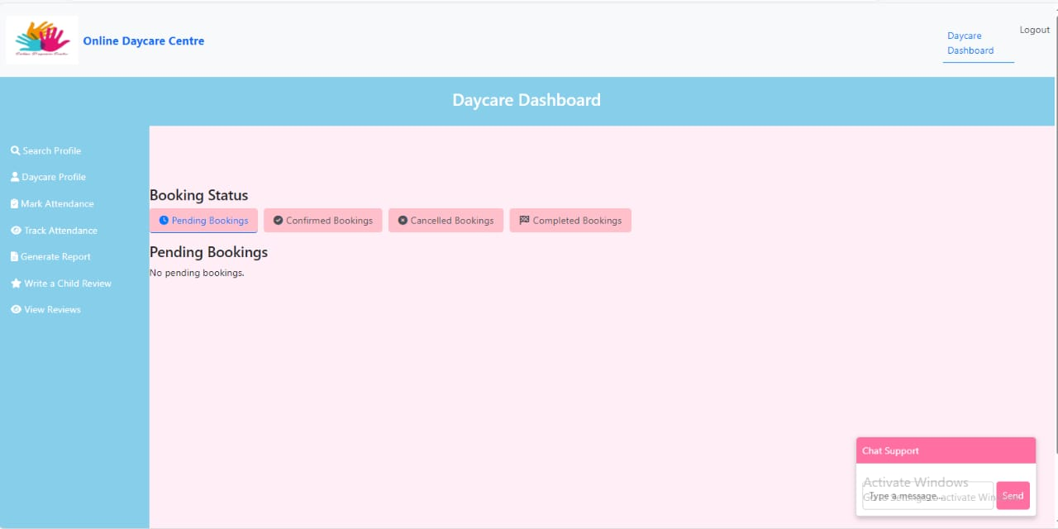
GUI (Daycare dashboard)

Slide 31
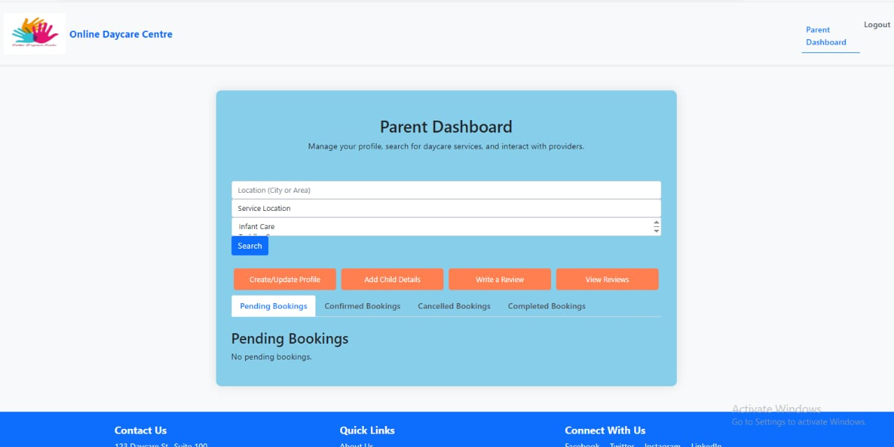
GUI (Payrent dashboard)

Slide 32
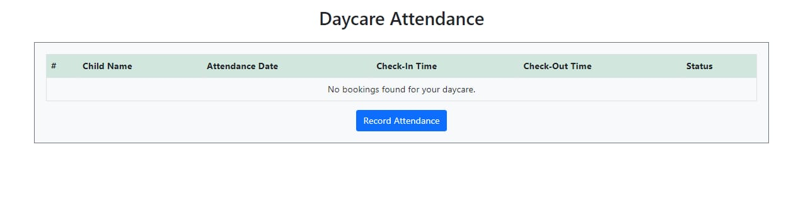
GUI (DAYCARE ATTANDANCE)

Slide 33
GUI (MANAGE DAYCARE PICTURE)

Slide 34
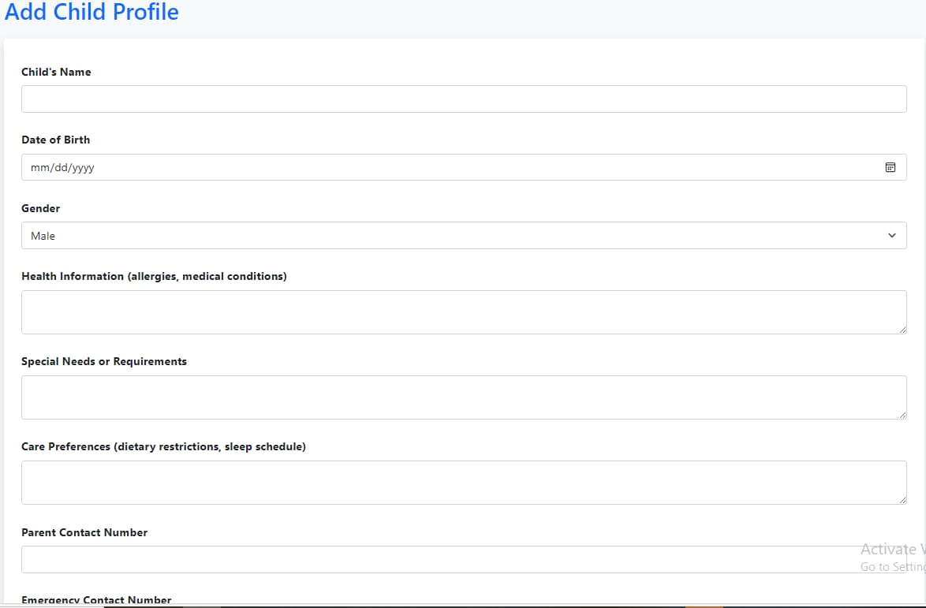
GUI (ADD CHILD PROFILE)

Slide 35
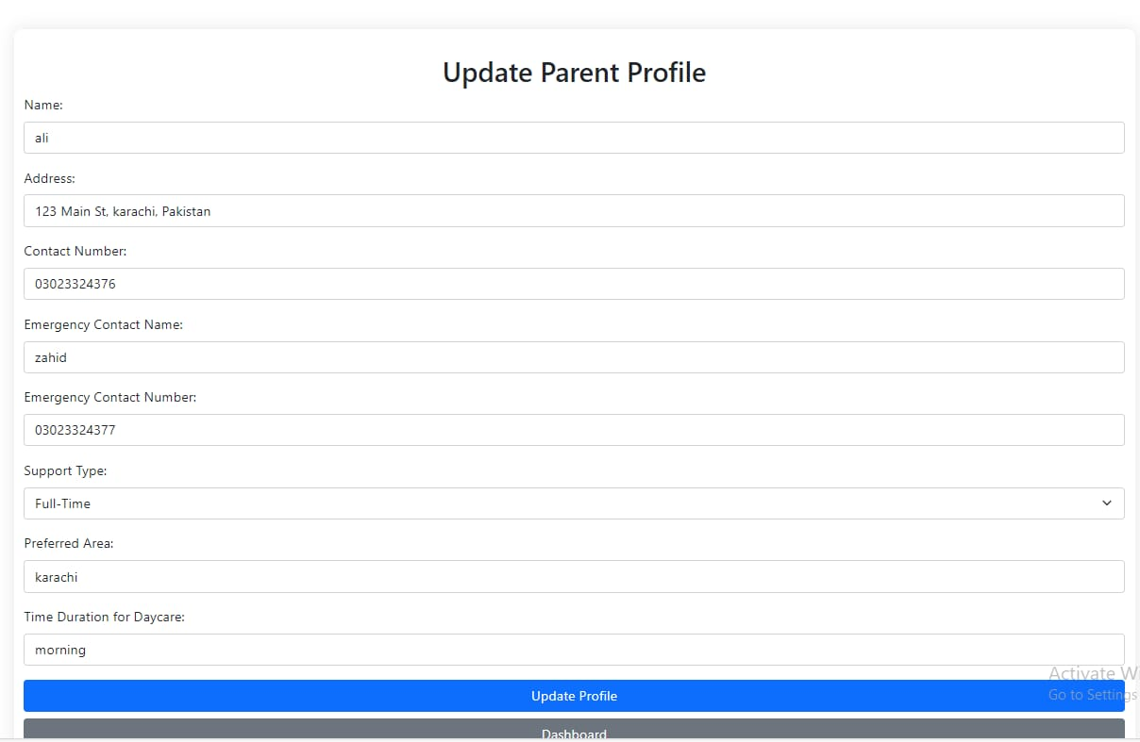
GUI (update CHILD PROFILE)

Slide 36
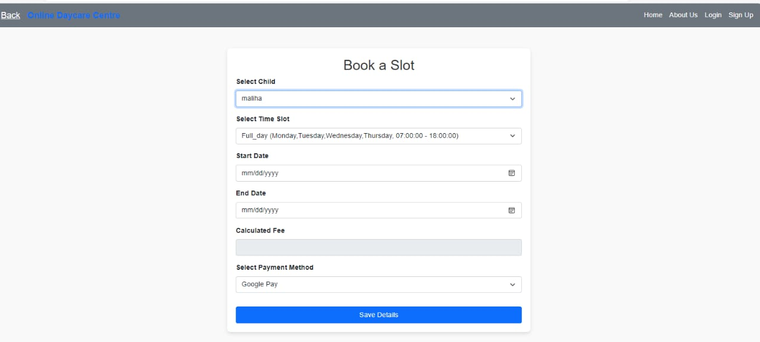
GUI (booking a slot)

Slide 37
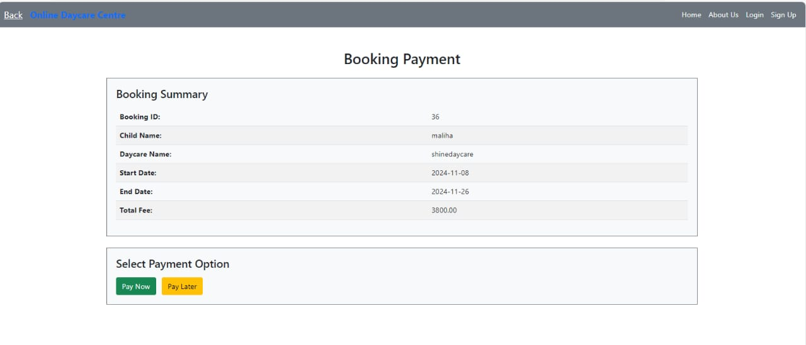
GUI (booking payment)

Slide 38
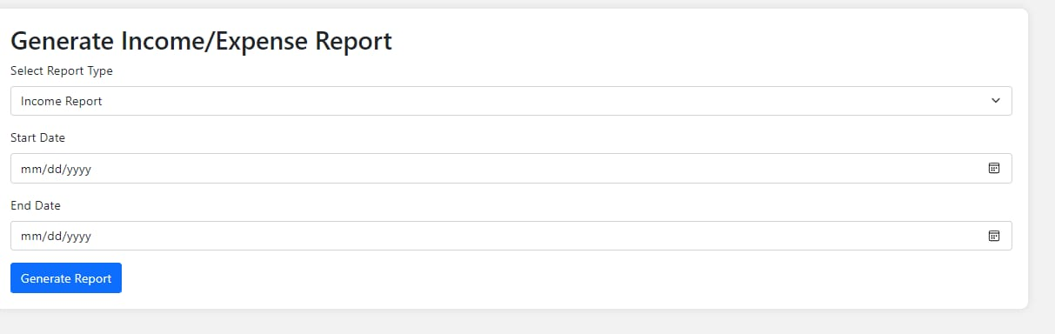
GUI (generate expense report)

Slide 39
Languages & tools
VS CODE 2023
XAMPP Control Panel v3.2.4
MS Visio 2016
Microsoft Word 2013
Microsoft Power Point 2013
Microsoft Excel 2013

Slide 40
Defination, acronyms & abbrevation
HTML (Hyper Text Markup Language)
CSS (Cascading Style Sheet)
PDO(Hyper text Processor)
DBMS (Database Management System)
SQL (Structure Query Language)

Slide 41


Presented by:
Asia Abbas
Abiaz Zahra

